Slide 1
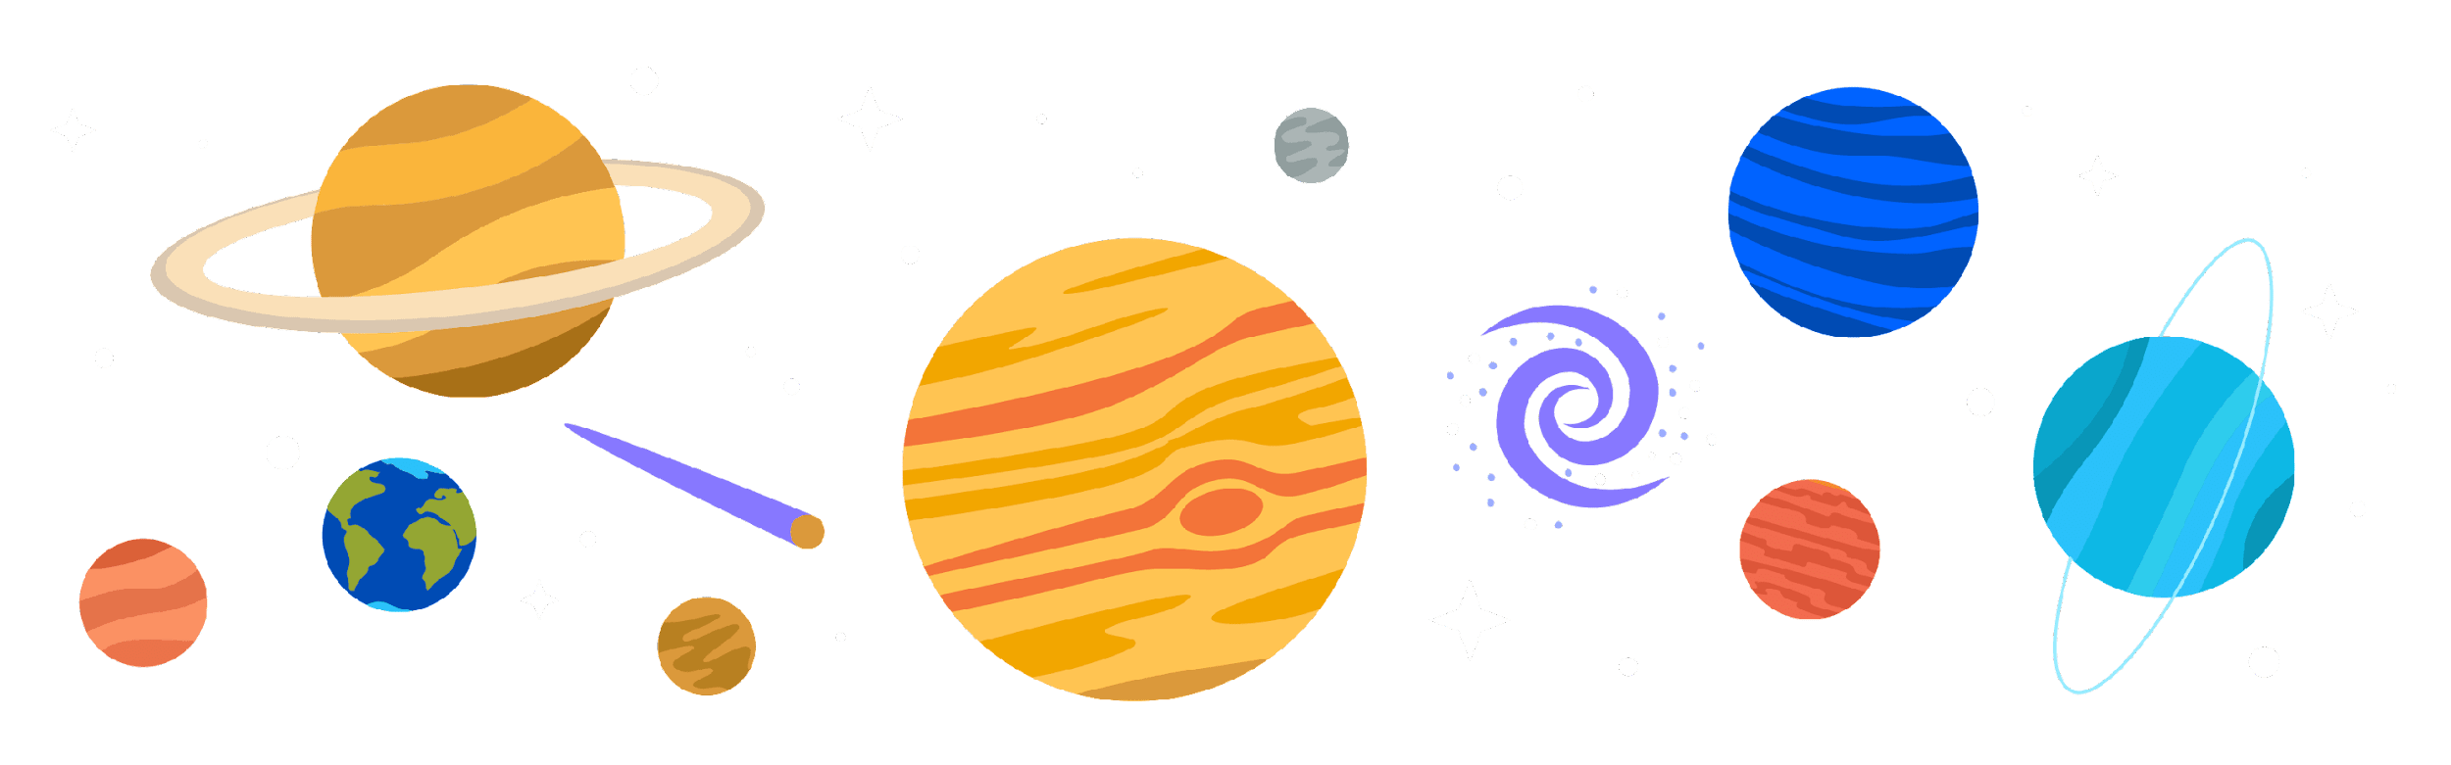
Galaxies, stars and the solar system
Chapter 35

Slide 2

Define what a star is
Explain the lifecycle of a star

Slide 3
Key words
stars
Supernova
Nuclear fusion
luminous
Black hole
Notes:
Supernova – explosion of a star
Black hole - a region of space having a gravitational field so intense that no matter or radiation can escape.

Slide 4
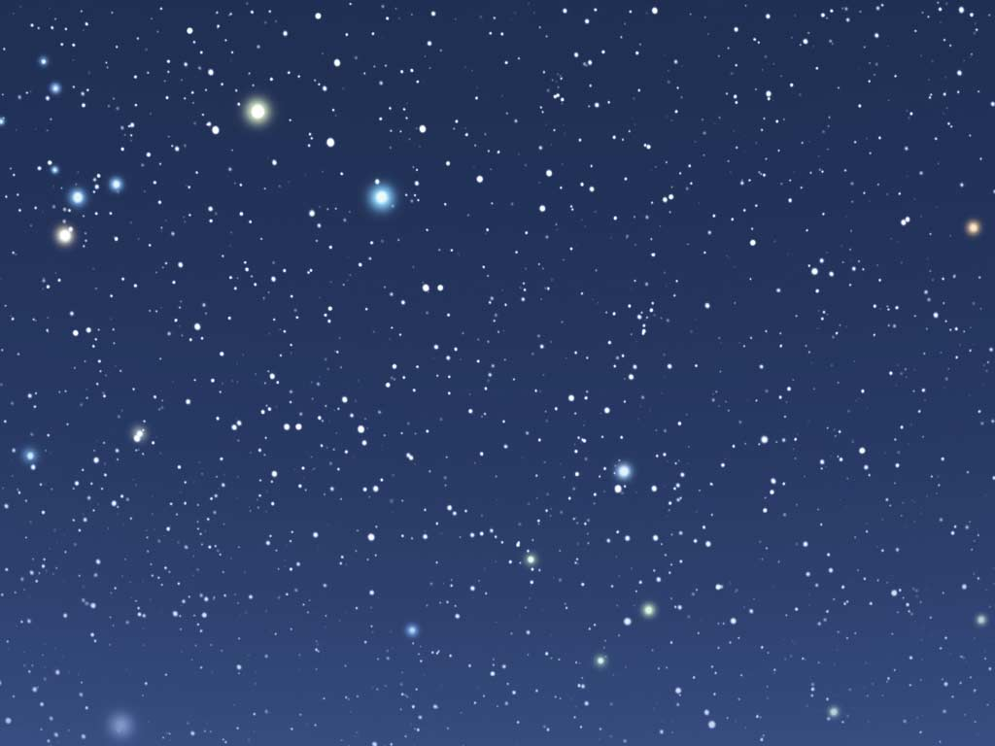
What are stars
A star is an object made up of gas.
its luminous (light source) and this is a result of nuclear reactions.

Slide 5
What are nuclear reactions
Nuclear reactions that take place in a star occur between two hydrogen atoms
. Nucleus of one hydrogen atom fuses with the nucleus of another hydrogen atom, creating a new element called helium.
The conversion of hydrogen to helium releases the heat and light - luminous star

Slide 6
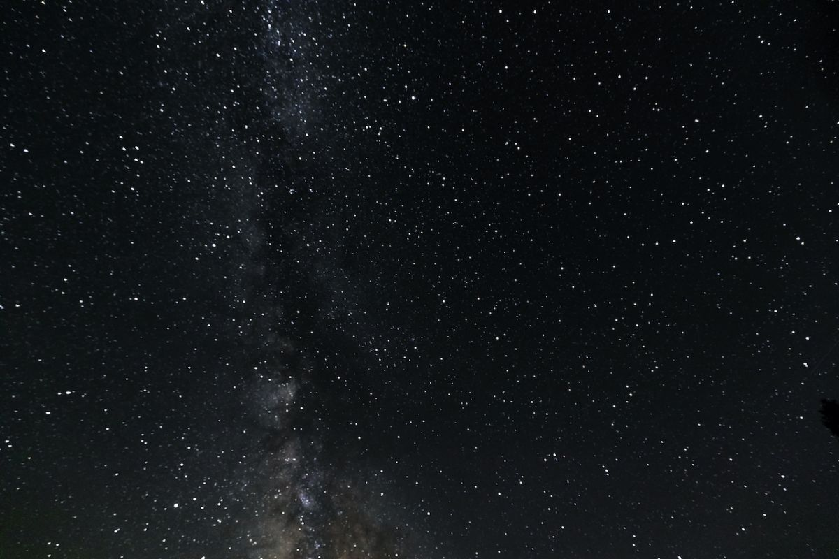
Do stars last forever?

Slide 7
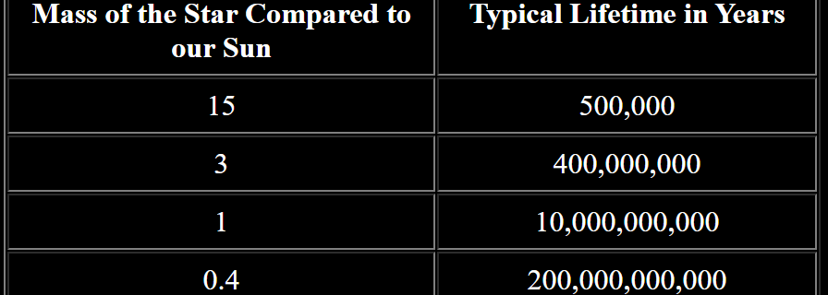
Do stars last forever?
Some stars have only a small amount of matter; some stars have a large amount of matter.
Some stars explode during the process of dying, releasing light, called a supernova
Notes:
Do any stars last forever?
No. Stars are born, live, and die. This process is called the "life cycle of a star".
Generally, the more massive the star, the faster it burns up its fuel supply, and the shorter its life.
The greater the star's mass, the shorter its lifecycle.

Slide 8
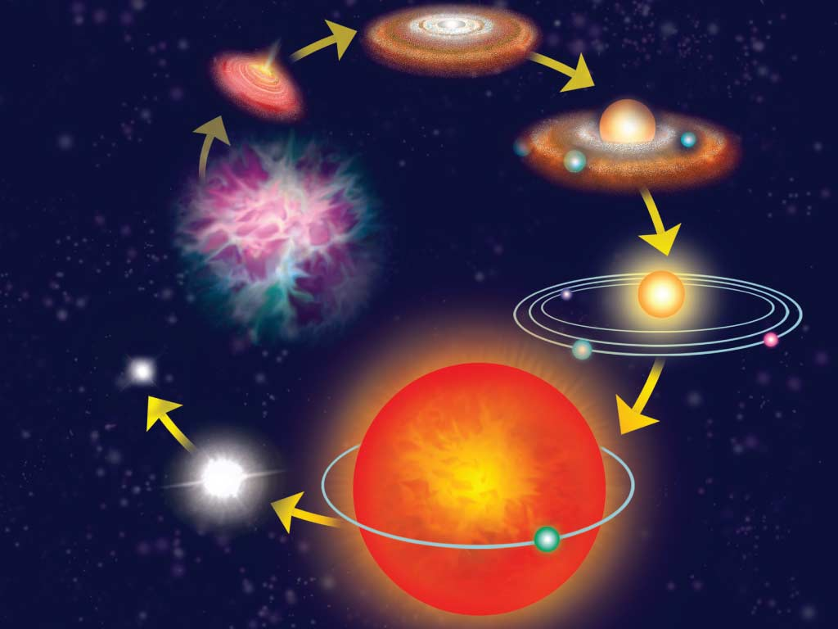
Lifecycle of a star
Phase 1 ‒ formation
Phase 2 ‒ the stable period
Phase 3 ‒ the red giant
Phase 4 ‒ the white dwarf
Notes:
It may take millions of years or it may take billions of years for a star to complete its life cycle

Slide 9
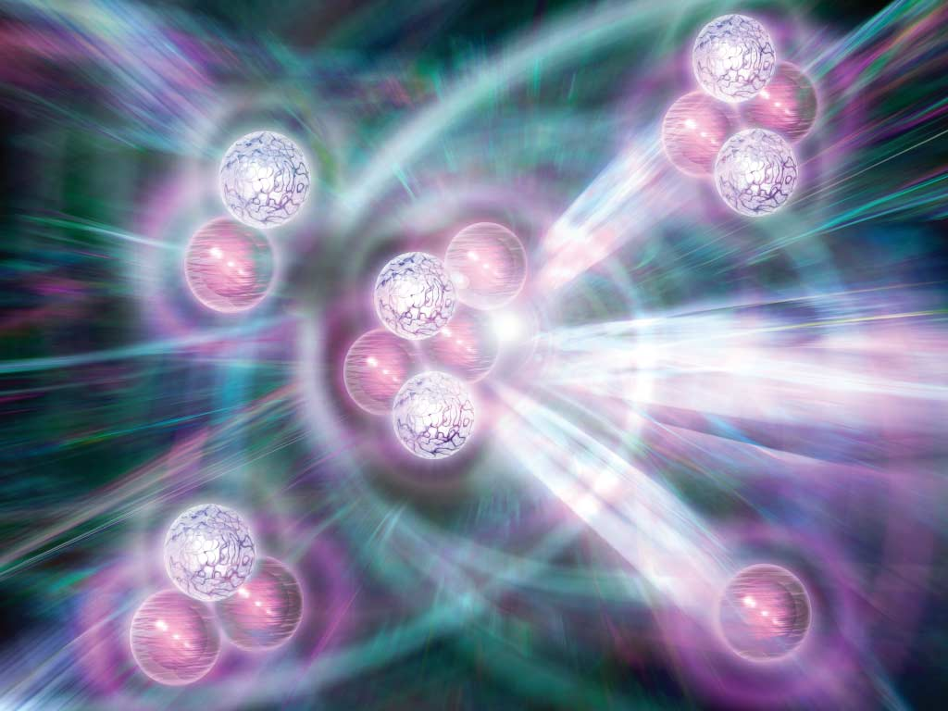
Phase 1 – formation
Large gas clouds in space, called nebulae.
The attractive forces of gravity cause gases to collapse and come together.
Increasing temperature and pressure within the nebulae causes gas to spin rapidly, causing the nuclei of elements to join together (nuclear fusion) and a star is created.

Slide 10
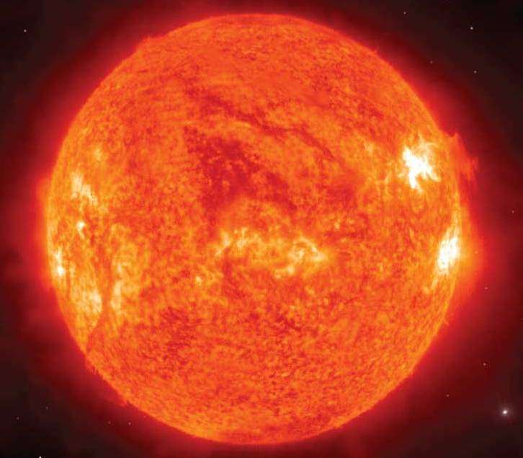
Phase 2 – The stable period
Over billions of years stars becomes stable, called a main sequence star.
A star spends the majority of its life as a main sequence star.
The star is using up all its available resource of hydrogen in nuclear reactions to emit heat and light energy.
Notes:
Most of the time a star shines, it is in a stage of its life cycle called the main sequence. How long it stays in the main sequence phase depends on how much mass the star has. Very big stars have a lot of mass to use as nuclear fuel to make it glow. However, they use that fuel at a very big rate. So, even though they are big, they live the shortest lives. You can see the typical main sequence lifetimes of stars of various masses in the table below.

Slide 11
Phase 3 – The red giant
The star used up all its supplies of hydrogen in its core, it begins burning helium on its outer parts.
This causes the star to release more heat.
As a result, the outer part of the star expands.
The star now becomes a huge structure, and is known as a red giant.

Slide 12
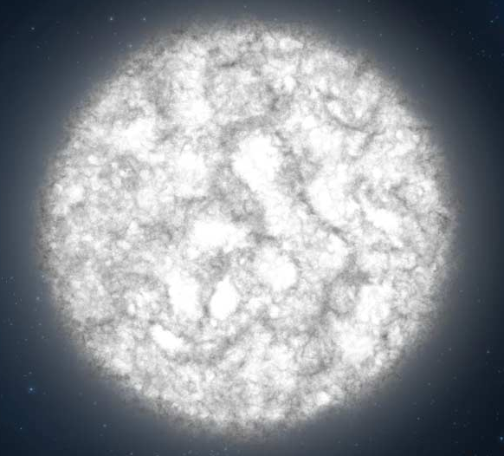
Phase 4 – The white dwarf
Once the red giant has turned all the hydrogen to helium
Star condenses and collapses, forming a tiny star called a white dwarf.
Has one-quarter of its original mass left.
The white dwarf will produce less and less light until eventually it produces no more light.

Slide 13
Describe what a galaxy is and what’s inside it.
Discuss what the solar system is and the arrangement of the planets

Slide 14
Key words
Universe
Orbit
Solar system
Galaxy
Gravity
Notes:
Supernova – explosion of a star
Black hole - a region of space having a gravitational field so intense that no matter or radiation can escape.

Slide 15
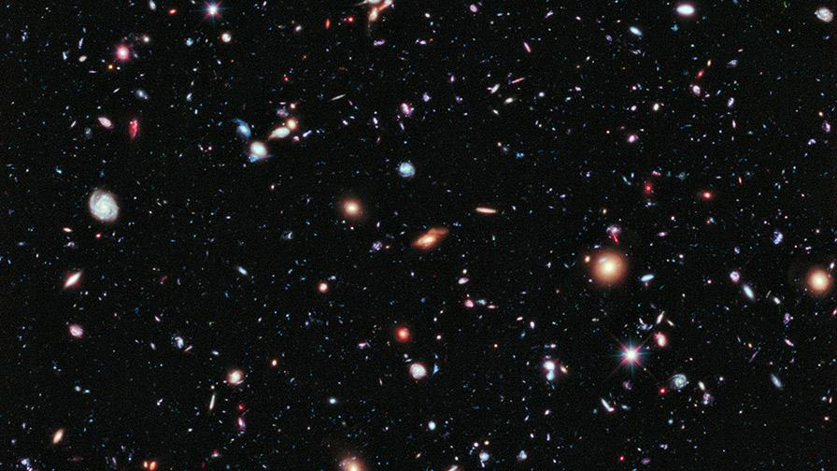
What is in the universe ?
Notes:
Galaxies, stars

Slide 16
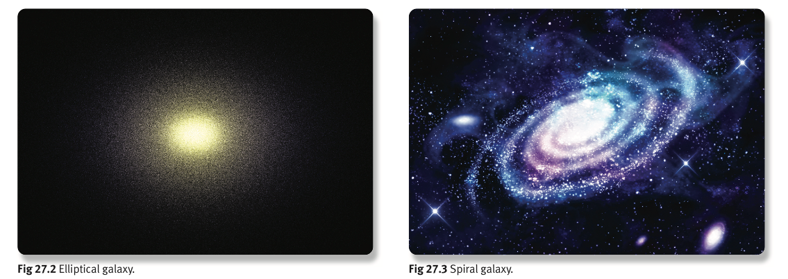
Galaxies
A galaxy is a collection of millions or billions of stars, along with gas and dust, all held together by gravitational forces.
Galaxies are constantly moving away from each other.
A galaxy can be elliptical or spiral-shaped.
Notes:
Earth is in the Milky Way galaxy
Earth is located in one of the spiral arms of the Milky Way (called the Orion Arm)
SS - which is the most common galaxy shape in the universe.

Slide 17
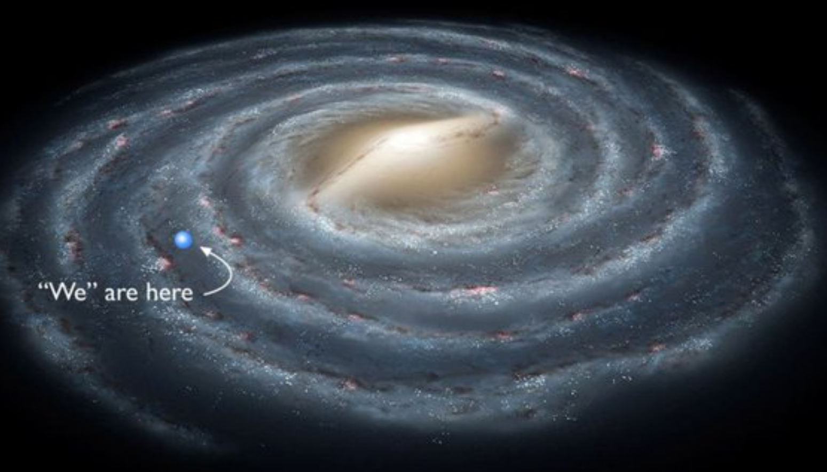

Slide 18
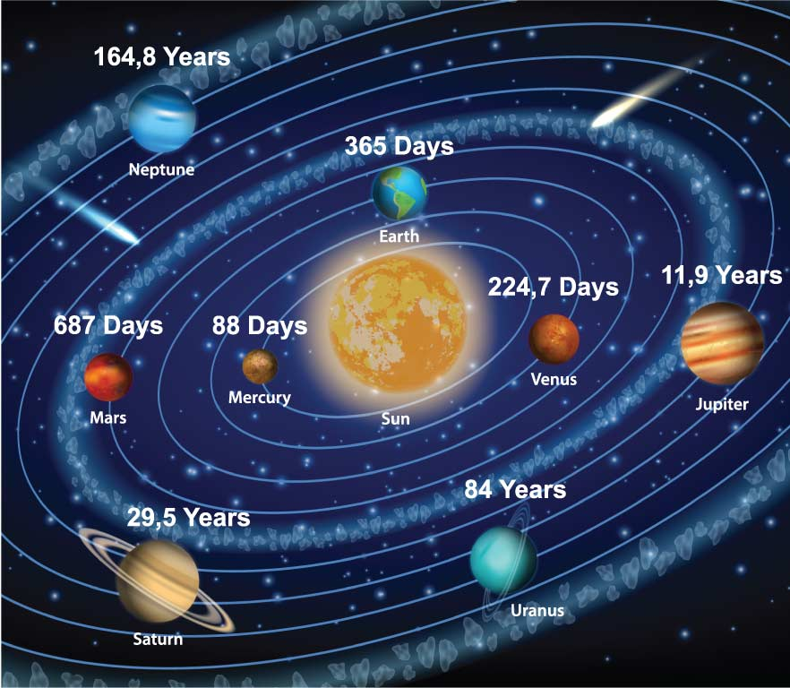
Our solar system
Our solar system is made up of the Sun and the planets that orbit (to travel around) around it.
Notes:
A planet's orbital speed changes, depending on how far it is from the Sun. The closer a planet is to the Sun, the stronger the Sun's gravitational pull on it, and the faster the planet moves.

Slide 19
What determines how fast planets orbit the sun
Notes:
A planet's orbital speed changes, depending on how far it is from the Sun. The closer a planet is to the Sun, the stronger the Sun's gravitational pull on it, and the faster the planet moves.

Slide 20
Gravity
Is a force a planet and other bodies have that pulls objects towards their centers.
The bigger the mass the greater the gravity.
Therefore, the gravity of the Sun holds the planets in their orbit around the Sun.
Notes:
WHAT IS GRAVITY?
Gravity is the force that pulls objects towards the Earth. It’s the reason we walk on the ground rather than float around.
Gravity also holds Earth and the other planets in their orbits around the Sun.

Slide 21
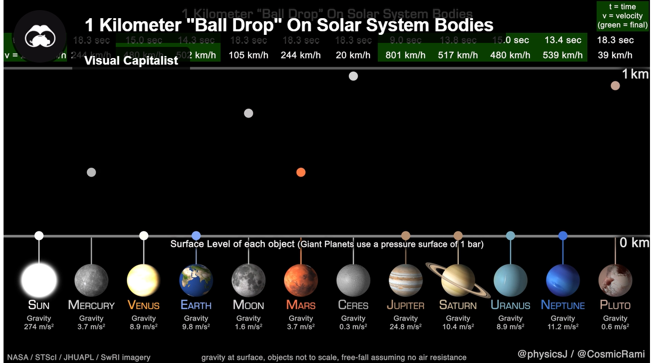
What three solar systems have the greatest gravitational pull
Notes:
https://www.weforum.org/agenda/2021/08/visualizing-gravitational-pull-planets-solar-system

Slide 22
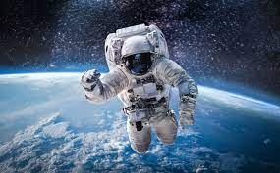
An astronaut in space is weightless. Has the astronaut the same mass in space as on earth?
Explain your answer
Notes:
An astronaut’s mass on Earth and in space is equal. This is because mass is defined as the amount of matter an object contains. What will change is the person’s weight. This force is related to the combined sum of their mass and the acceleration due to gravity, of the object or structure they are located on. An astronaut will appear ‘weightless’ in space due to the fact they have pulled away from Earth’s gravitational pull. However, their mass will still be the same as their mass on Earth. With future learning, students will learn that the length of time an astronaut spends in space usually results in the loss of muscle and bone mass, which can lead to a reduction of the mass of the astronaut. However, for the purpose of this question you are trying to facilitate the students’ understanding that it is the effect of gravity that changes and not mass

Slide 23
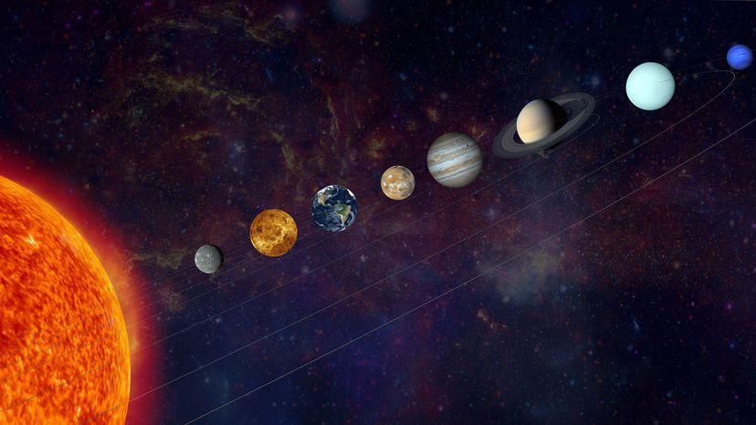
Planets

Slide 24
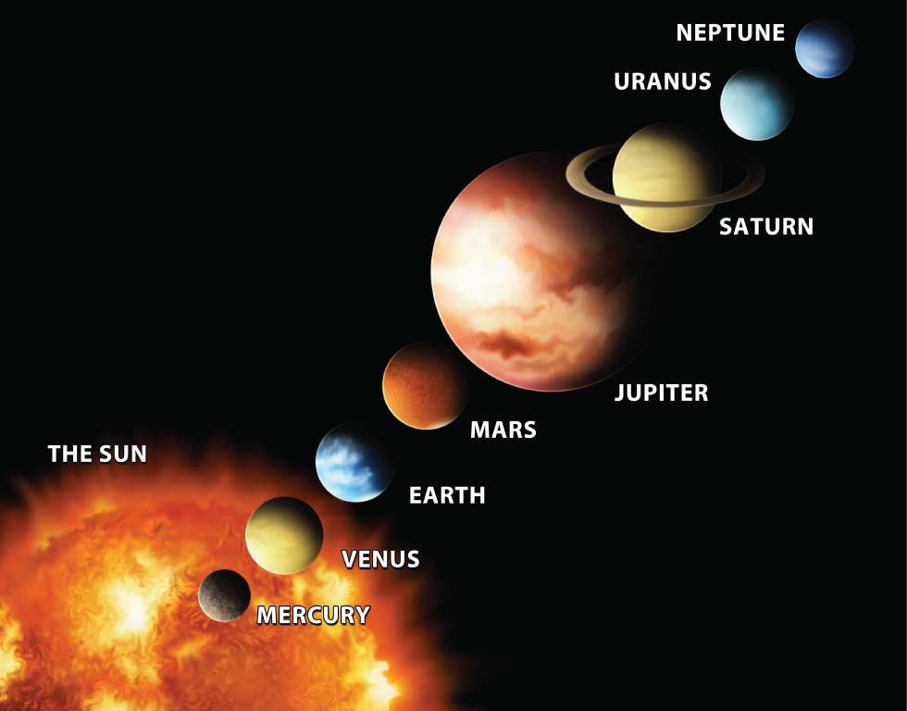
Notes:
https://joshworth.com/dev/pixelspace/pixelspace_solarsystem.html – Distance of planets

Slide 25
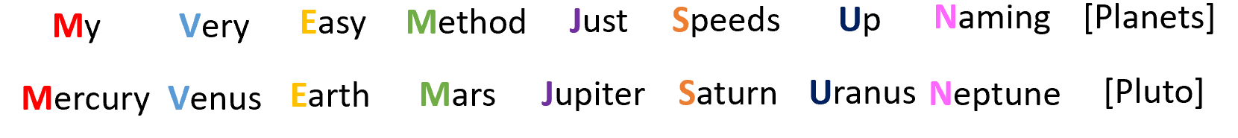
Planets
Within our solar system there are three types of planet:
Terrestrial planets
Jovian planets
Dwarf planets, or planetoids.

Slide 26
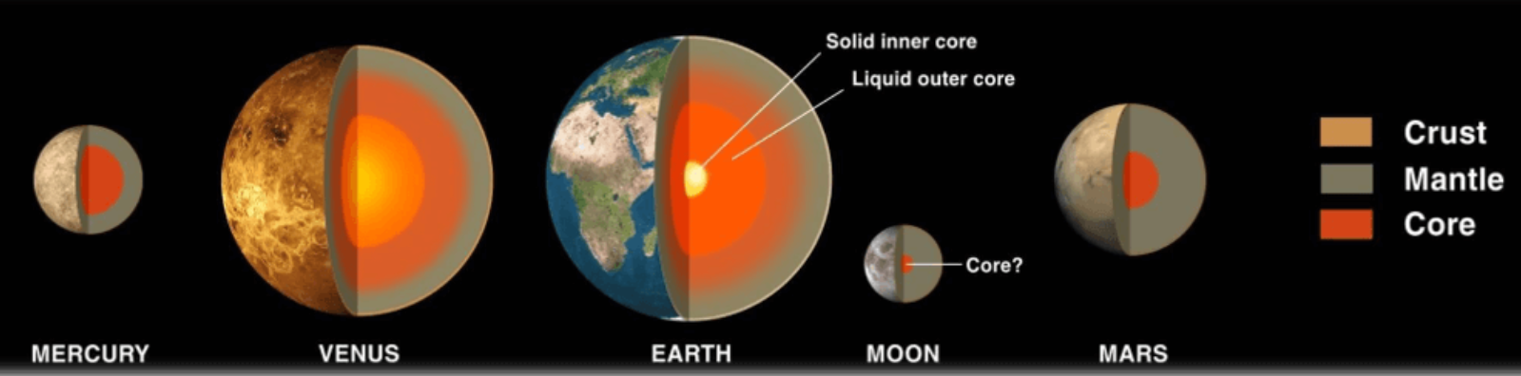
Terrestrial planets
The four inner planets (Mercury, Venus, Earth and Mars) are known as terrestrial (rocky) planets.
Each of these planets has a solid inner core, liquid mantle and a solid crust.

Slide 27
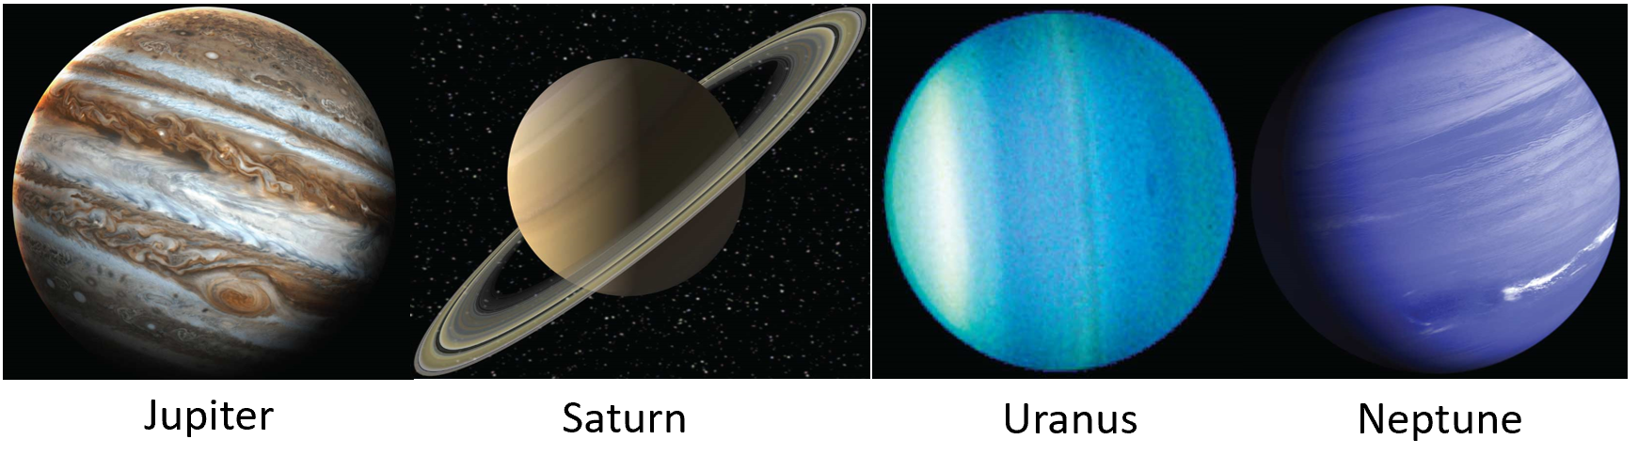
Jovian planets
The Jovian planets are the gas giants in our solar system
Gas Giant: planets made up of gas & water
Jupiter & Saturn composed of helium and hydrogen.
Uranus & Neptune composed of ices.
They are very large and have rings around them.

Slide 28
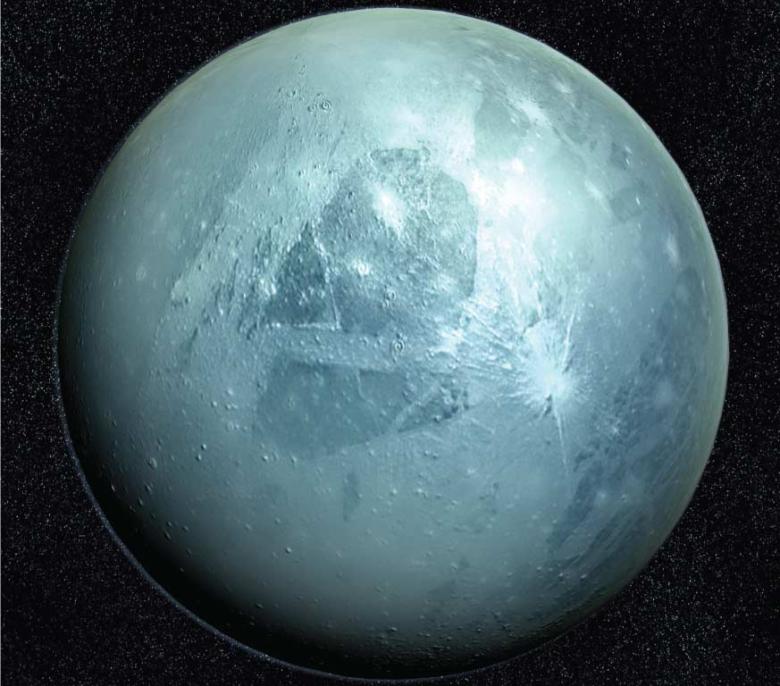
Planetoid planet
A planetoid is a ‘dwarf’ planet. These are objects that are:
Too large to be asteroids (which are rocky bodies located in our solar system)
Too small to be planets.

Slide 29
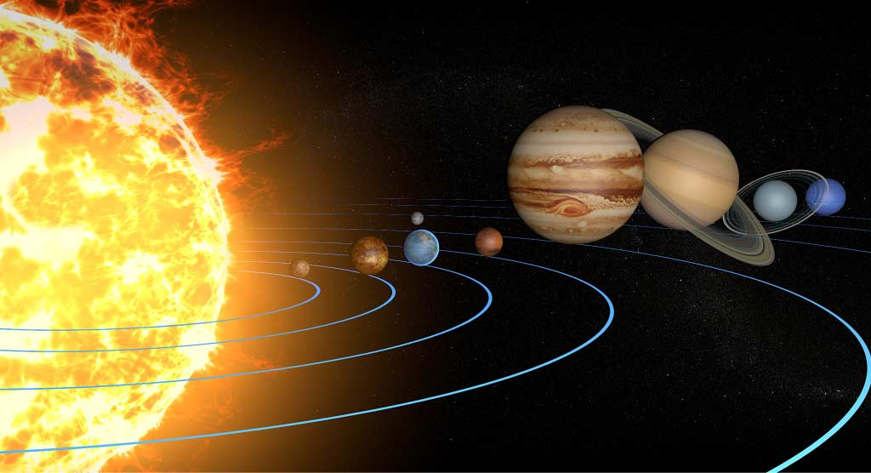
How do planets orbit
The planets orbit around the Sun.
The Sun is a very large object and as a result has a very large gravity. The Sun’s gravity ‘pulls’ planets towards it.
At the same time the planets are always trying to pull away from the Sun out into space. But the Sun’s gravity keeps each of the planets in a curved orbit.

Slide 30
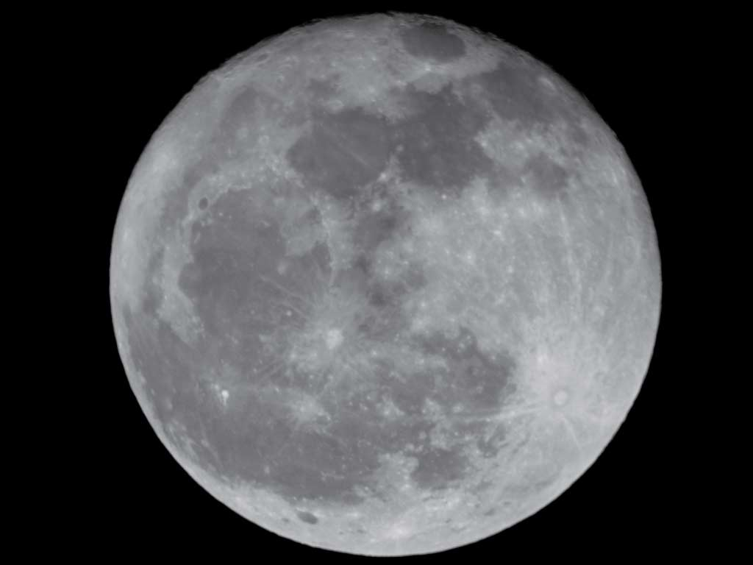
Is there more than one moon?
Moons are objects that are found revolving around planets in our Solar System.
Some planets, such as Earth, have one moon. Other planets have more than one moon – Jupiter, for example, has 79 moons.

Slide 31
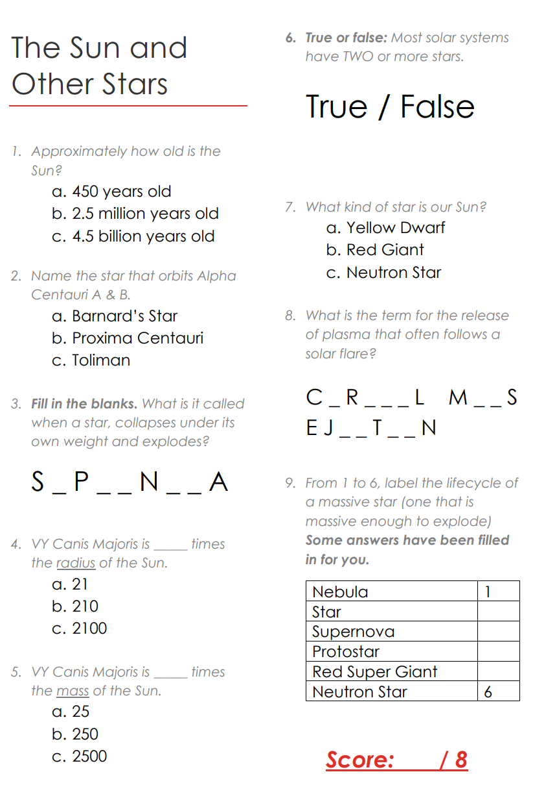

Slide 32
